Slide 1
Operating System
Threading

Slide 2
Cooperating Processes
Last time we discussed how processes can be independent or work cooperatively
Cooperating processes can be used:
to gain speedup by overlapping activities or working in parallel
to better structure an application as set of cooperating processes
to share information between jobs
Sometimes processes are structured as a pipeline
each produces work for the next stage that consumes it

Slide 3
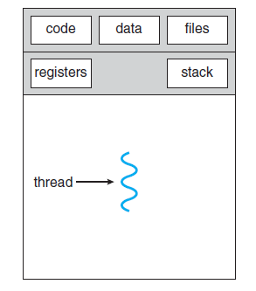
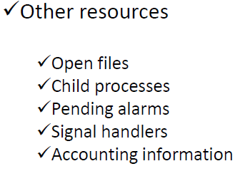
Process Overheads
A full process includes numerous things:
an address space (defining all the code and data pages)
OS resources and accounting information
a “thread of control”,
defines where the process is currently executing
That is the PC and registers
Creating a new process is costly
all of the structures (e.g., page tables) that must be allocated
Context switching is costly
Implict and explicit costs as we talked about

Slide 4
Need something more lightweight
What’s similar in these processes?
They all share the same code and data (address space)
They all share the same privileges
They share almost everything in the process
What they don’t share?
Each has its own PC, registers, and stack pointer
Idea: why don’t we separate the idea of process (address space, accounting, etc.) from that of the minimal “thread of control” (PC, SP, registers)?

Slide 5
Threads and Processes
Most operating systems therefore support two entities:
the process,
used to group resources together and defines the address space and general process attributes
the thread,
which defines a sequential execution stream within a process

Slide 6
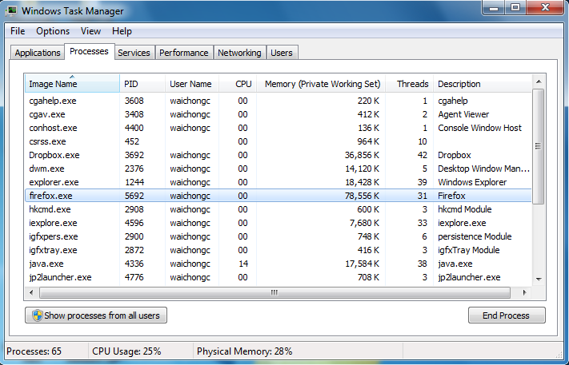
What is a Thread?

Slide 7

The VERY Basic Idea
Process
Thread

Slide 8
Process and Thread
Traditional process has a single thread of control, so one process can perform only one task at a time.
If process has multiple threads of control, then it can perform more than one task at a time.
If the operating system has thread facility, then thread will be the basic unit of CPU utilization.
Now modern operating system allows a process to have multiple threads inside.

Slide 9
Process Management
CPU
Process
Output
Process
CPU
Output
Thread
Process
CPU
Output
Thread
Thread

Slide 10


Process and Thread
Chrome
Chrome Process
Thread 1
Thread 2
Load
Thread 3
Thread 4
Program Code
Thread 5
Thread 6
Thread 7
Thread 8
Executable
File
Main Memory
Thread 1
Thread 2
Thread 3
Thread 4
Thread 5

Slide 11
Process and Thread
Chrome P1
Chrome Process
Chrome P2
Thread 1
Thread 2
Chrome P3
Load
VS
Thread 3
Thread 4
Program Code
Chrome P4
Chrome P5
Thread 5
Thread 6
Thread 7
Thread 8
Executable
File
Main Memory
P1 / T1?
P2 / T2?
P3 / T3?
P4 / T4?
P5 / T5?

Slide 12
Process and Thread
Despite of the fact that a thread must execute in process, the process and its associated threads are two different concepts.
Processes are used to group resources together.
Threads are the entities scheduled for execution on the CPU.
Unit of execution is referred to as a thread.
Like a Container

Slide 13
The Changes to the Structure of Process with Thread

Slide 14
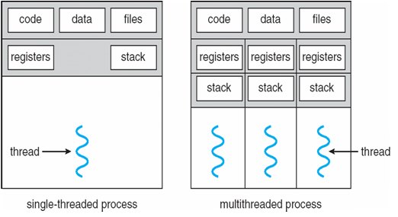
Process and Thread
A thread has its own Thread Control Block (TCB) that contains thread ID, program counter, registers, stack, and small control block.
Each threads has its own stack because thread can call different functions or procedures and thus a different execution history.
It shares the code section, data section, and resources with other threads belonging to the same process.
Share

Slide 15
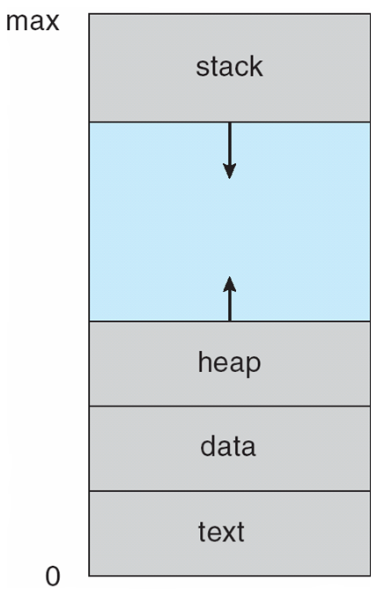
Example
facebook
news
wikipedia
eLearn
chrome.exe
chrome.exe
chrome.exe
chrome.exe
chrome.exe
chrome.exe
chrome.exe
chrome.exe
kernel
Main
Memory

Slide 16
Example
facebook
news
wikipedia
eLearn
chrome.exe
chrome.exe
stack
stack
stack
reg
reg
reg
code
data
heap
kernel
Main
Memory

Slide 17
Thread Resources
Creating a process requires allocating PCB, the memory map (heap, data, text, and stack), list of open files, and environment variables.
Allocating and managing the memory map is typically the most time-consuming activity.
Creating a thread involves allocating (existing) smaller data structure to hold a register set, stack, and priority.

Slide 18
Thread Resources
The creation of a new process differs from that of a thread mainly in the fact that all the shared resources of a thread are needed explicitly for each process.
Two processes also do not share other resources with each other. This makes the creation of a new process very costly compared to that of a new thread.

Slide 19

Example
chrome.exe
chrome.exe
Request Memory
chrome.exe
chrome.exe
Rearrange
chrome.exe
chrome.exe
chrome.exe
chrome.exe
mpaint.exe
mpaint.exe
kernel
kernel
Main
Memory
Main
Memory
OS has to “explicitly” allocate memory to the process.

Slide 20
Example
T1
T2
T3
chrome.exe
stack
stack
stack
reg
reg
reg
T4
T5
T6
stack
stack
stack
reg
reg
reg
code
data
heap
kernel
Main Memory
After the resources are secured by the process:
Create threads or work with the allocated memory easily.

Slide 21
Process and Threads (Similarity)
Threads also can be in one of the five states, e.g. New, Ready, Running, Waiting and Terminated.
The OS can switch between different threads for the CPU to execute, even though they belong to a single process.

Slide 22
Process and Thread (Differences)
Threads are not independent of one another.
Design to assist one other or cooperating with each others.
Processes might or might not assist one another.
All threads can access every address in the process.
A process is unable to gain access to the address space of another process, unless permission is granted.

Slide 23
Benefits and Challenges of using Thread

Slide 24
Benefits of using Threads in OS
Responsiveness
Allow a program to continue running even if part of it is blocked or is performing a lengthy operation (a multithreaded web browser).
Resource Sharing
Threads share the resources of the process which they belong by default.
Economy
Creation and context-switch of threads can be 30x and 5x faster than processes (Solaris).
Scalability
Can easily increase or decrease the number threads running in parallel in multiprocessor architecture.
Communicate through shared data eliminates the overhead of system calls (message passing).

Slide 25
Applications Benefit from Threads: Interactive GUI Programs
Most of the interactive GUI programs. Users can continue to interact with the program while the program is doing something else in the background.
Word Processor Program
Thread 1: Displaying graphics.
Thread 2: Reading in keystrokes from the user.
Thread 3: Perform spelling & grammar check in background.
Web Browser
Thread 1: Handle the interaction.
Thread 2: Downloading a file.
Thread 3: Loading a video.

Slide 26
Challenges
Dividing
Activities
Examining application to identify the areas that can be divided into separate, concurrent tasks.
Balance
Ensure divided tasks perform equal work. If a task contributes less, then it is not worth to run that on another processing core.
Data Splitting
Similar to dividing tasks, the data accessed and manipulated by the tasks must be divided to run on another processing core.

Slide 27
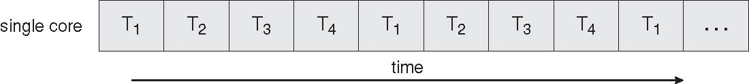
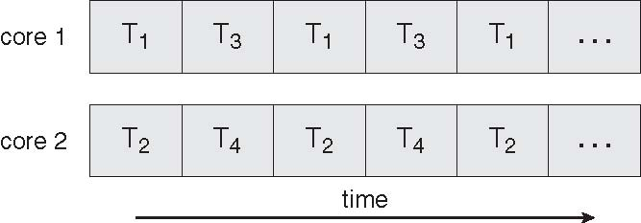
Parallel Execution on a Multicore System

Slide 28
Challenges
Data Dependency
Data accessed by different threads must be examined for dependencies. Programmers need to synchronize the task.
Testing
&
Debugging
Testing and debugging of concurrent programs is inherently more difficult.

Slide 29
Support for Thread in Operating System

Slide 30
Support for Threads
In fact, support for threads in an operating system may be provided either at the user level for user threads, or by the kernel for kernel threads.
Model
Combined
Many-to-Many
Two-Level
Pure User Threads
Many-to-One
One-to-One
Pure Kernel Threads

Slide 31
Support for Threads
User Threads
Kernel Threads
Processer
Mapping Model

Slide 32
Support for Threads
User Process
Task
Created By
User Thread
User Thread
CPU
Kernel Thread
Fetch
Operating System (Kernel)
Created By

Slide 33
Types of Threads
User-level threads- implement in user-level libraries, rather than via systems calls, so thread switching does not need to call operating system and to cause interrupt to the kernel.
In fact, the kernel knows nothing about user-level threads and manages them as if they were single-threaded processes.
Three primary thread libraries:
POSIX Pthreads
Windows threads
Java threads

Slide 34
Types of Threads
Kernel level threads-In this method, the kernel knows about and manages the threads.
No runtime system is needed in this case. Instead of thread table in each process, the kernel has a thread table that keeps track of all threads in the system.
In addition, the kernel also maintains the traditional process table to keep track of processes.
Operating Systems kernel provides system call to create and manage threads.
Examples – virtually all general purpose operating systems, including:
Windows
Solaris
Linux
Mac OS X

Slide 35
Multithreading Models
Many-to-One
One-to-One
Many-to-Many

Slide 36
Many-to-One
Many user-level threads mapped to single kernel thread
One thread blocking causes all to block
Multiple threads may not run in parallel on muticore system because only one may be in kernel at a time
Few systems currently use this model
Examples:
Solaris Green Threads
GNU Portable Threads

Slide 37
One-to-One
Each user-level thread maps to kernel thread
Creating a user-level thread creates a kernel thread
More concurrency than many-to-one
Number of threads per process sometimes restricted due to overhead
Examples
Windows
Linux
Solaris 9 and later

Slide 38
Many-to-Many Model
Allows many user level threads to be mapped to many kernel threads
Allows the operating system to create a sufficient number of kernel threads
Solaris prior to version 9
Windows with the ThreadFiber package

